Slide 1
Joined up thinking: Authoritative student input from from course rep to president
Simon Varwell
Development Advisor
Thursday 14 August 2014

Slide 2
Who is sparqs?
Student Participation in Quality Scotland
www.sparqs.ac.uk
@sparqs_scotland

Slide 3
Joined up thinking?
“Representative” representatives.
Authoritative, researched input.
Respected officers.
Confident, reassured management.
Productive, constructive partnership.
An enhanced learning experience!

Slide 4
A basic college structure
College board & management
College committees
SA executive
Heads of departments
Department committees
Department representatives
Teaching and support staff
Course committees
Course reps

Slide 5
Staff
Structures
SA
College board & management
College committees
SA executive
Heads of departments
Department committees
Department representatives
Teaching and support staff
Course committees
Course reps

Slide 6
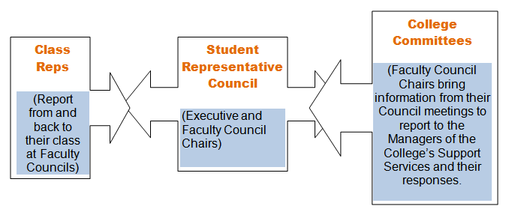
Borders College

Slide 7
Show us yours!
Using the handout, describe your college and SA structure.
What bits do you (not) know about?
Who would you find out from?
Where are the strengths and weaknesses?

Slide 8
Staff
Structures
SA
College board & management
College committees
SA executive
Heads of departments
Department committees
Department representatives
Teaching and support staff
Course committees
Course reps

Slide 9
A joined up course rep system
SA executive
Department representatives
Course reps

Slide 10
A joined up course rep system
Well-trained and supported reps.
Able to listen to their course mates.
Aware of their wider subject areas.
Meet up by subject/department.
Common issues easy to identify.
Can report back to classes.

Slide 11
Course rep system resources
sparqs’ course rep training!
Online resources on your VLE.
Supplementary training.
Regular meetings.
Staff to support, research and mentor.

Slide 12
Joined up dep reps
SA executive
Department representatives
Course reps

Slide 13
Joined up dep reps
Time to devote to the role.
Good supporters of course reps.
Able to spot common issues/trends.
Can present an evidence-based case.
Can report back to course reps.

Slide 14
Dep rep resources
sparqs’ Departmental Representation toolkits.
Regular support and mentoring.
Departmental staff.
Regular team meetings and training.

Slide 15
Joined up senior officers
SA executive
Department representatives
Course reps

Slide 16
Joined up senior officers
Time to devote to the role.
Good supporters of dep reps.
Able to spot common issues/trends.
Can present an evidence-based case.
Can report back to dep reps.

Slide 17
Senior officer resources
College Student Leaders.
Other resources from NUS/sparqs.
In-house training.
Students’ association staff.
College staff.
Board members.

Slide 18
Staff
Structures
SA
College board & management
College committees
SA executive
Heads of departments
Department committees
Department representatives
Teaching and support staff
Course committees
Course reps

Slide 19
What you can do
Discuss strengths/weaknesses with SA colleagues, college management and others.
Look at your college’s student engagement strategy and SA strategic plan (or create them!).

